Slide 1
Saville’s Country Florist
Zachary Hyde
Tameet Ranu
Amera Stacy
Kelly Stockman

Slide 2
Background
Family owned business operating since 1952
Sell Flower Arrangements
Locally located in Orchard Park

Slide 3
Issue with Operations
Current database system is inefficient
Lacks information
Slow navigation
Poor system of organization

Slide 4
Proposed Solution
New database provides efficient use of technology
Looks to add business value
Introduction of advertising
Decreasing wasteful costs
Widen customer base

Slide 5
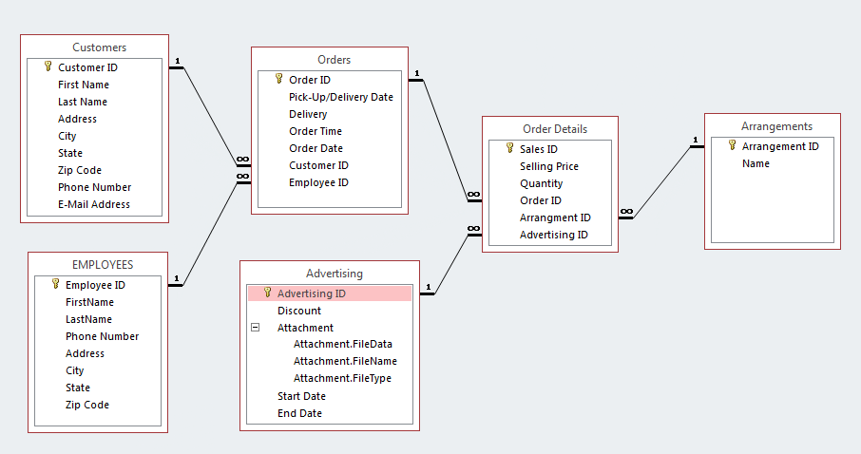
Database Design Overview

Slide 6
Project Demonstration

Slide 7
Conclusion
New database solves many problems
Greater efficiency
Eliminates wasteful costs
Increase customer satisfaction indirectly

